Slide 1


Old Woman Creek
Team - InSuKa:
Indra Teja Chintakayala, Wancheng Sun, Kalpana Jha

Slide 2
Agenda
Background
Target Audience
Research Questions
Analysis of Data
Limitation of Data
Conclusion

Slide 3
OWC Background
Ohio’s only national estuarine sanctuary and became a state nature preserve in 1980.
It is a habitat for nearly 300 bird species(including bald eagles), 40 fish species, and hundred of native plants.
Focuses on Phenology-based species monitoring for understanding how climate trends are affecting species.
Host to a number of wildlife species as well as species that are a keystone to ecological functioning.
It has avian monitoring points to monitor birds activity.
Bald eagle nest monitoring was initiated to track eagle recovery.

Slide 4
Target Audience
Emily Kuzmick-Coastal Training Program Coordinator at OWC.
Volunteers recording monitoring data.
Scientists and Students interested in researching at OWC
Employees at OWC

Slide 5
Research Questions
Bald Eagle nesting
Relationship between Nest Status, Temperature, Wind velocity.
Avian Monitoring data
Compare kind of indicator species per each year, and their total count

Slide 6
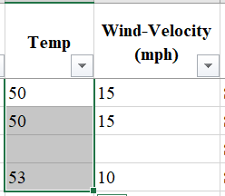
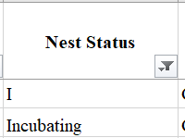
Bald Eagle nesting - Limitation
Uncleaned data
Missing data
Temperature, Nest Status, etc had missing values
Data Inconsistencies

Slide 7
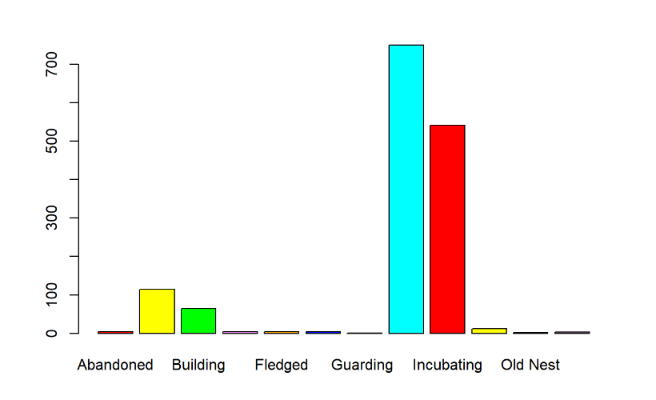
Bald Eagle nesting - Analysis
Barplot for frequency - Nest status
Hatching
Branching

Slide 8
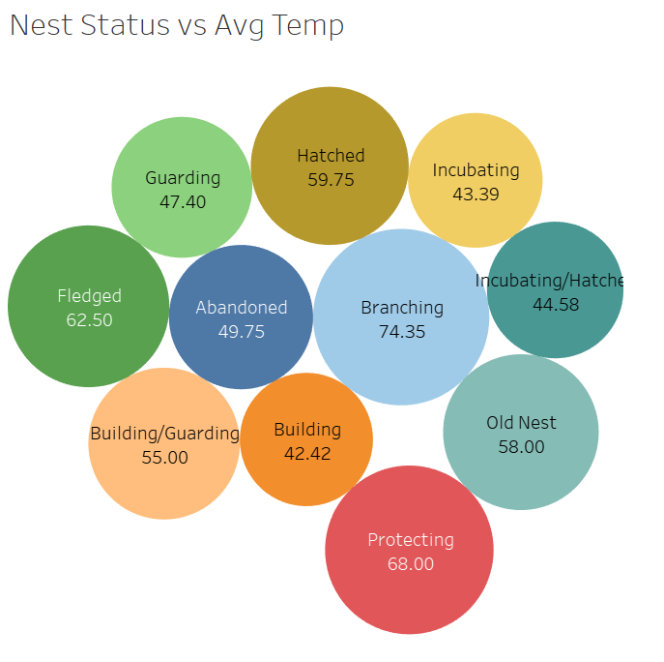
Bald Eagle nesting - Analysis

Slide 9
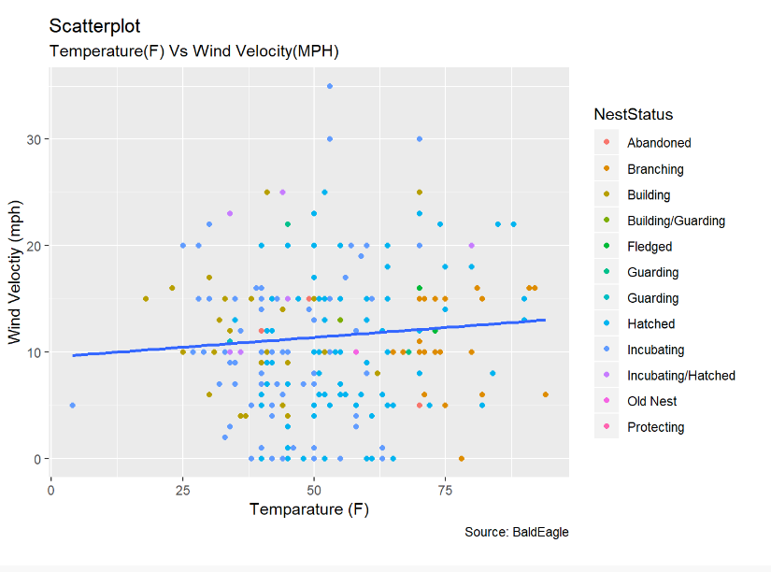
Bald Eagle nesting - Analysis
ScatterPlot: Temperature vs Wind Velocity for ‘Nest Status’

Slide 10
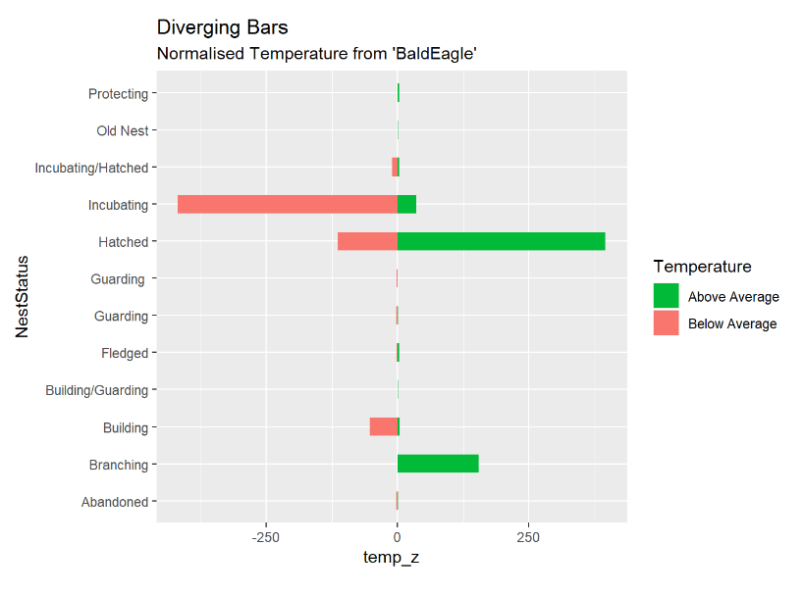
Bald Eagle nesting - Analysis
z = (x – μ) / σ

Slide 11
Bald Eagle nesting - Conclusion
Data consistency and clean data is important
Nest status “hatched” has highest occurence
Average temperature for all Nest status is above 40 F
From scatterplot we can concluded Bald eagles are comfortable
Temperature range of (15 - 85) F
Wind velocity around (10 - 15) mph
From Temperature(z) Normalization, we can conclude that
Nest status “hatched”, “Branching” is above average temperature
Nest status “Incubating”, “building” is below average temperature

Slide 12
Avian Monitoring data - Limitation
We only focus on the five indicator species.
Canada Goose (CAGO)
Great blue hero (GBHE)
Marsh Wren (MAWR)
Wood Duck (WODU)
Wood Thrush (WOTH)
We only focus on three years.
2016 year
2017 year
2018 year

Slide 13
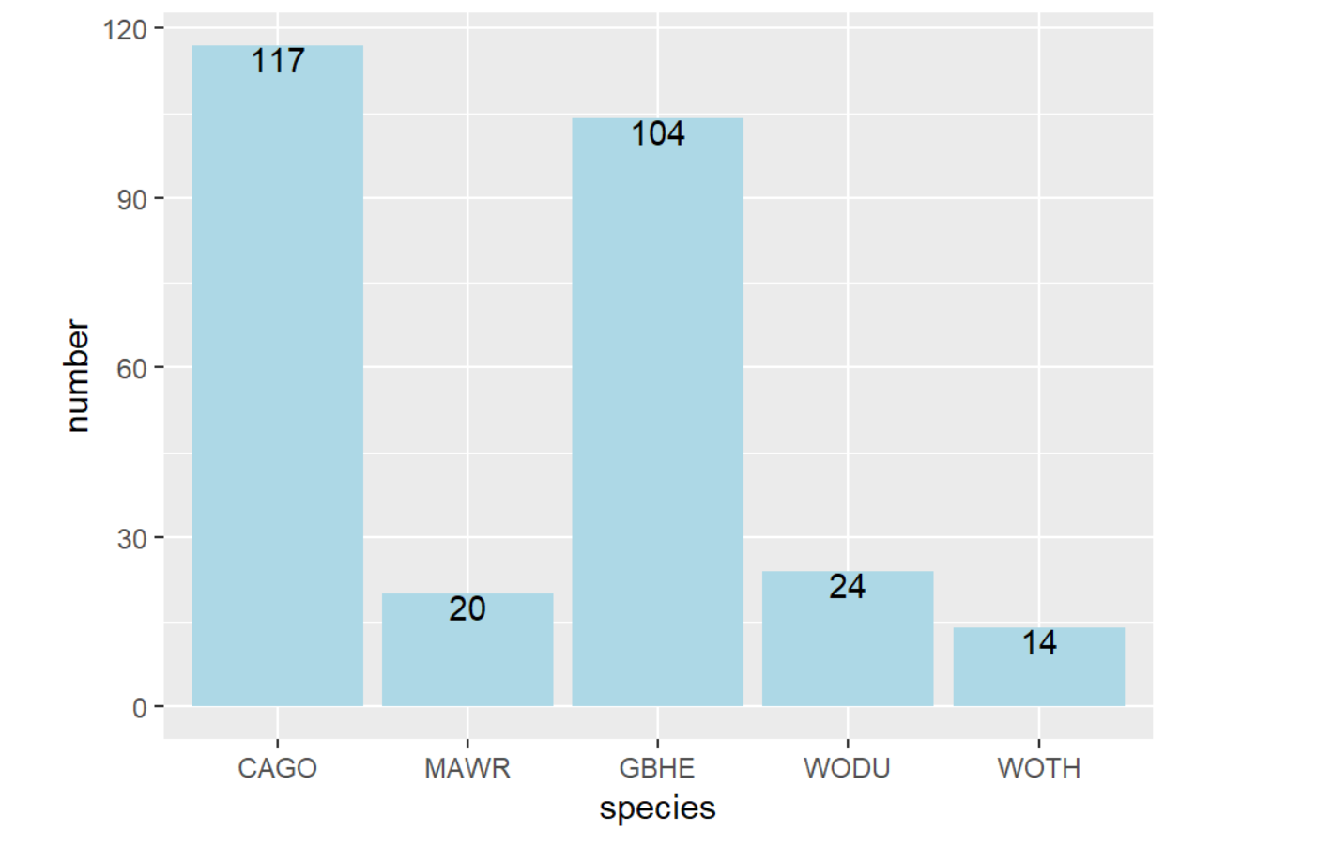
Avian Monitoring data - Analysis

Slide 14
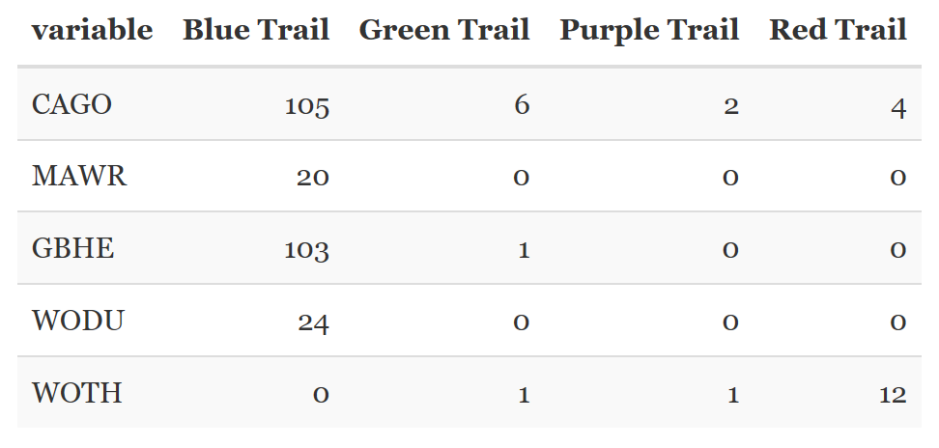
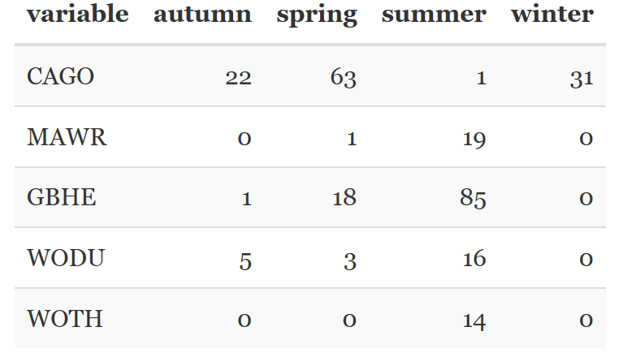
Avian Monitoring data - Analysis

Slide 15
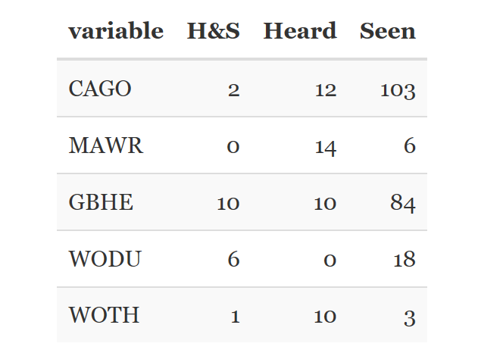
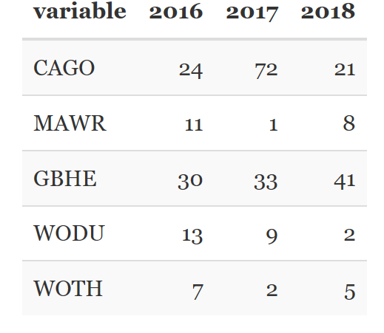
Avian Monitoring data - Analysis

Slide 16
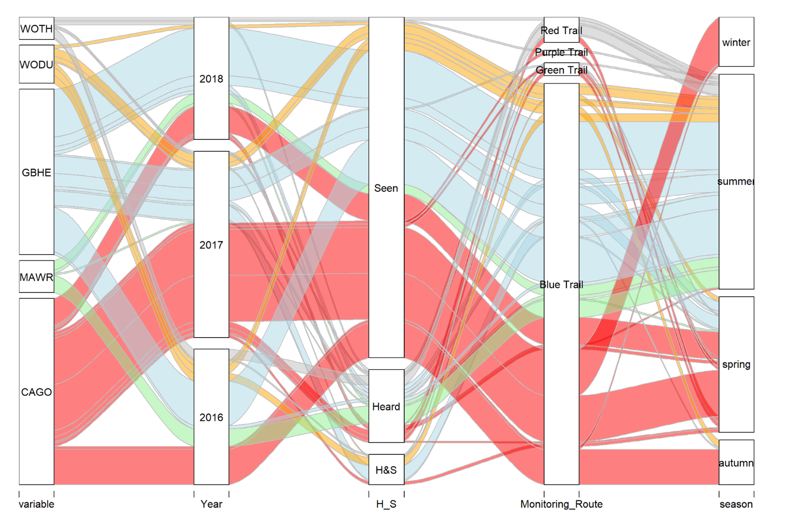
Avian Monitoring data - Analysis

Slide 17
Avian Monitoring data - Conclusion
The number of species drops down, so we should pay more attention to protect them.
Each species has its unique season to be observed.
Blue trail is most suitable and comfortable route for species habitat.

Slide 18
Github Repository and Rpub links
https://github.com/IndraTeja/OldWomanCreek
http://rpubs.com/indrateja/owc-final

Slide 19
Thank you!

